Slide 1
Software Quality
Lecture 8
Ruzanna Chitchyan, Jon Bird, Pete Bennett
TAs: Alex Elwood, Alex Cockrean, Casper Wang​
Notes:
RC

Slide 2
Overview
Software quality and how to get to it
Test-driven development
White box testing
Black box testing
Notes:
Introduce the objectives for the module.
软件质量及其实现方法
测试驱动的开发
白盒测试
黑盒测试

Slide 3
Software Quality

Slide 4
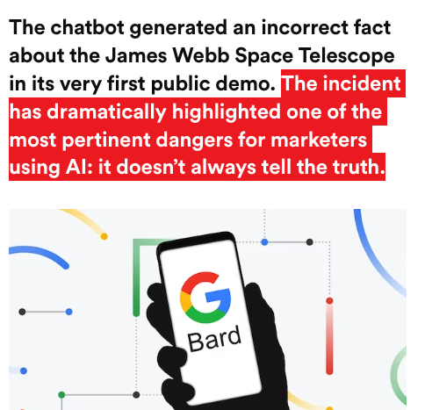
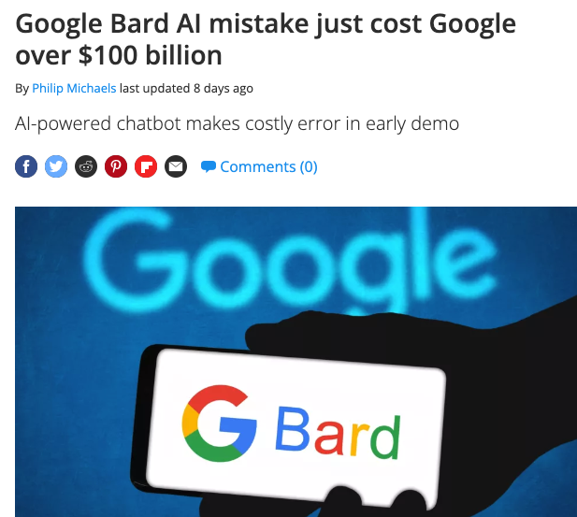
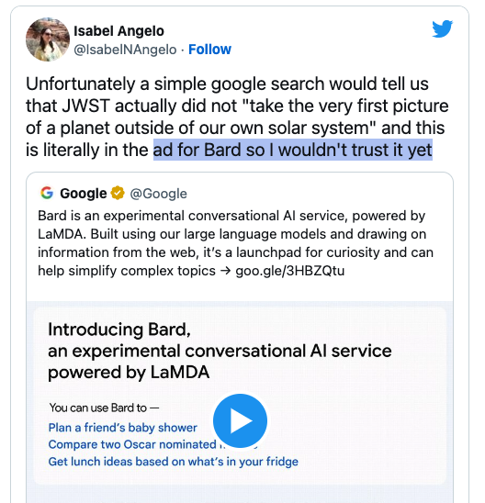
Why is Software Quality relevant: Case of Bard (Gemini)
https://www.tomsguide.com/news/google-bard-ai-is-off-to-an-embarrassing-start
https://www.thedrum.com/news/2023/02/09/attention-marketers-google-s-100bn-bard-blunder-underscores-current-dangers-using-ai

Slide 5
Why is Software Quality relevant?
Reputation
Cost of Product and Maintenance
Software Certification
Organizational Certification
Legality
Moral/ethical codes of practice
Notes:
Reputation Software developers and their organisations rely on reputation. A poor quality product (or family of products) can be enormously damaging for business. Software bugs can have immediate impacts on custom, especially in customer-facing industries. The automotive software problems with Volkswagen have led to an enormous amount of negative publicity, which has a direct impact on sales.
Limiting Costs of Product and Maintenance Cost is an overriding factor in software development. Poor quality software tends to be expensive to develop and to maintain, which can have a detrimental effect on business. Poor software quality can lead to technical debt, where the organisation in charge of the software needs to invest a disproportionate amount of resources into maintaining and running the software to make up for (and to try and remedy) poor design and implementation decisions.
Software Certification Depending on the domain of the software (e.g. in Aircraft or Rail), the development and use of software might be restricted, and dependent on obtaining some form of certification. For example, software in modern civilian aircraft often has to be certified to the DO178 standard, which requires the extensive use of software quality assurance procedures throughout the software development lifecycle.
Organisational Certification The organisational procedures and structures that are employed for software development can have a huge bearing on the quality of the software they produce. There are various ways by which to categorise the extent to which an organisation employs good practice. International certification procedures and standards such as CMM and ISO90017 exist, so that software development organisations can advertise their “capability” to develop high quality software.
Legality Depending on the country, there may be overriding legal obligations that apply to organisations that use software. For example, in the UK, organisations have to demonstrate that the risk posed by their technology (this includes software) is “As Low As Reasonably Practicable” or “ALARP” . In other words, every “practicable” measure must have been taken to demonstrate that (in our case) the software system does not pose a risk to its users.
Moral / ethical codes of practice Even in cases where a software system is not covered by industrial certification and legislation, and where its failure is not necessarily business or safety-critical, there can remain a moral obligation to the users. Professional organisations such as the American Computer Society (ACM) have explicit ethical guidelines and codes of practice, with statements such as “Software engineers shall act consistently with the public interest”. This clearly implies that they ought to do whatever possible to maximise the quality of their software and to prevent it from containing potentially harmful bugs.
声誉软件开发人员及其组织依赖声誉。一个质量低劣的产品（或产品系列）可能会对企业造成巨大损害。软件缺陷会对定制产生直接影响，尤其是在面向客户的行业。大众汽车的汽车软件问题导致了大量的负面宣传，直接影响了销量。
限制产品成本和维护成本是软件开发中最重要的因素。质量差的软件往往开发和维护成本高昂，这可能会对业务产生不利影响。糟糕的软件质量可能会导致技术债务，负责软件的组织需要投入不成比例的资源来维护和运行软件，以弥补（并试图补救）糟糕的设计和实施决策。
软件认证根据软件的领域（如飞机或铁路），软件的开发和使用可能会受到限制，并取决于获得某种形式的认证。例如，现代民用飞机中的软件通常必须经过DO178标准的认证，这要求在整个软件开发生命周期中广泛使用软件质量保证程序。
组织认证用于软件开发的组织程序和结构可能对他们生产的软件的质量产生巨大影响。有多种方法可以对组织采用良好实践的程度进行分类。CMM和ISO90017等国际认证程序和标准已经存在，因此软件开发组织可以宣传他们开发高质量软件的“能力”。
合法性根据国家的不同，可能有适用于使用软件的组织的压倒一切的法律义务。例如，在英国，组织必须证明其技术（包括软件）带来的风险是“合理可行的最低风险”或“ALARP”。换言之，必须采取一切“切实可行”的措施来证明（在我们的情况下）软件系统不会对其用户构成风险。
道德/伦理行为准则即使在软件系统不在行业认证和立法范围内，并且其故障不一定是商业或安全关键的情况下，用户仍有道德义务。美国计算机学会（ACM）等专业组织有明确的道德准则和行为准则，并声明“软件工程师应始终以公众利益为重”。这显然意味着他们应该尽一切可能最大限度地提高软件的质量，并防止其包含潜在的有害漏洞。

Slide 6
Software Quality is Multi-dimensional
Subjective or “fitness for use”: as perceived by an individual user (e.g., aesthetics of GUI, missing functionality…)
Objective or “conformance to requirements”: can be measured as a property of the product (e.g., detailed documentation, number of bugs, compliance with regulations …. )
Practical: what does it mean to your team and your clients?
Notes:
Fitness for use: Joseph Juran embodied the idea that the quality of product revolves around its fitness for use . He argued that, ultimately, the value of a product depends on the customer’s needs. Crucially, it forces the product developers to focus on those aspects of the product that are especially crucial (the vital few objectives) as opposed to the useful many.
Conformance to Requirements: Phil Crosby embodied a different tone. He defined quality as “conformance to requirements” . His opinion was that quality can be achieved by the disciplined specification of these requirements, by setting goals, educating employees about the goals, and planning the product in such a way that defects would be avoided.
主观或“适合使用”：由单个用户感知（例如，GUI的美观性、功能缺失…）
目标或“符合要求”：可以作为产品的特性来衡量（例如，详细的文档、缺陷数量、是否符合法规…）
实用：这对你的团队和客户意味着什么？
适合使用：Joseph Juran体现了产品质量围绕其适合使用的理念。他认为，归根结底，产品的价值取决于客户的需求。至关重要的是，它迫使产品开发人员专注于产品的那些特别关键的方面（关键的少数目标），而不是有用的许多目标。
符合要求：Phil Crosby体现了不同的语气。他将质量定义为“符合要求”。他的观点是，质量可以通过严格规范这些要求、设定目标、教育员工有关目标以及以避免缺陷的方式规划产品来实现。

Slide 7
Quality Models: ISO/IES25010

Slide 8
Steps Towards Software Quality:
Use a standard development process
Use a coding standard
Compliance with industry standards (e.g., ISO, Safety, etc.)
Consistent code quality
Secure from start
Reduce development costs and accelerate time to market
Define and monitor metrics (defect metrics and complexity metrics)
High complexity leads to higher number of defects
Identify and remove defects
Conduct manual reviews
Use Testing
Notes:
使用标准开发流程
使用编码标准
符合行业标准（如ISO、安全等）
一致的代码质量
从一开始就安全
降低开发成本并加快上市时间
定义和监控指标（缺陷指标和复杂性指标）
高复杂性导致更高数量的缺陷
识别并消除缺陷
进行手动审查
使用测试

Slide 9
Testing
Mauro Pezze and Michal Young. Software testing and analysis - process, principles and techniques. Wiley, 2007.

Slide 10
Testing process: key elements and relationships
From: M. Staats, M. W. Whalen, and M. P. E. Heimdahl. Programs, tests, and oracles: the foundations of testing revisited. In Software Engineering (ICSE), 2011 33rd International Conference on, pages 391–400. IEEE, 2011.
Notes:
System under Test (SUT) This is the system (or unit/function) being tested. It seeks to implement the specification.
The SUT can either be a white-box system, where we have complete access to the source code and the run-time state (e.g. the call-stack), or a black-box system, where we only have access to the external interface or API (depending on the type of system). It can also be a mixture of the two; for example, library routines might be provided in the form of closed source components, whilst the source code for the main core of the system is available for analysis. The system might be reactive where the input / output behaviour at one stage is affected by previous inputs (e.g. a GUI), or it might process inputs in a single batch and return to its initial state. This matters from a testing perspective, because in the reactive case, the test inputs have to be formulated as sequences.
The system might be deterministic, where it always returns the same answer for a given input. It might however also be non-deterministic, where the same input can elicit different outputs (perhaps because of randomised internal behaviour, or other factors beyond control such as thread-scheduling).
It is commonly important to ensure that the SUT is an isolated version of the “live” system.
Specification A specification represents the idealised behaviour of the system under test. Depending on the development context, this might be embodied as a comprehensive, rigorously maintained document (e.g. a set of UML diagrams or a Z specification). Alternatively, if developed in an agile context, it might be a partial intuitive description captured in a selection of user stories, test cases, and documented as comments in the source code.
The nature of the specification has an obvious bearing on testing. If a concrete, reliable specification document exists and there is a shared understanding of what the system is supposed to do, this can be used as the basis for a systematic test-generation process. If this is not the case, then testing becomes a more ad-hoc and dependent upon the intuition and experience of the tester.
Test cases The test cases correspond to the executions of the SUT. In practical terms a test case corresponds to an input (or a sequence of inputs) to the system.
Test cases should ideally cumulatively execute every distinctive facet of software behaviour. An ideal test set (collection of test cases) should be capable of exposing any deviation that the SUT makes from the specification. If it can be shown to do this, the test set is deemed to be adequate.
Test Oracle Executing the test cases alone will not determine whether the SUT conforms to the specification or not. This decision – whether or not the output of a test is correct or not – is made by a test oracle. In practice, an oracle might be an assertion in the source code that is checked during the test execution, or it might be the human user, deciding whether or not the behaviour is acceptable.
Test oracles are notoriously difficult to produce. There is in practice rarely an explicit, comprehensive, up to date specification that can be used as a reference. A successful software has usually been developed over the course of decades by a multitude of developers, which means that, ultimately, there is rarely a definitive record of how exactly the system should behave. What’s more, there may be tens of thousands of test cases, each of which might produces complex outputs, which can make the task of manual validation of the outputs prohibitively time consuming. These issues are collectively referred to as the oracle problem.
测试中的系统（SUT）这是正在测试的系统（或单元/功能）。它寻求实现规范。
SUT既可以是白系统，我们可以完全访问源代码和运行时状态（例如call-stack），也可以是黑系统，我们只能访问外部接口或API（取决于系统类型）。它也可以是两者的混合物；例如，库例程可以以闭源组件的形式提供，而系统主要核心的源代码可用于分析。当一个阶段的输入/输出行为受到先前输入（例如GUI）的影响时，系统可能是被动的，或者它可能在单个批次中处理输入并返回到其初始状态。从测试的角度来看，这很重要，因为在被动的情况下，测试输入必须被公式化为序列。
该系统可能是确定性的，对于给定的输入，它总是返回相同的答案。然而，它也可能是不确定性的，其中相同的输入可能引发不同的输出（可能是因为随机的内部行为，或其他无法控制的因素，如线程调度）。
通常重要的是要确保SUT是“实时”系统的独立版本。
规范一个规范代表了被测系统的理想化行为。根据开发上下文的不同，这可能体现为一个全面的、严格维护的文档（例如一组UML图或Z规范）。或者，如果在敏捷环境中开发，它可能是在用户故事、测试用例的选择中捕获的部分直观描述，并作为注释记录在源代码中。
规范的性质对测试有着明显的影响。如果存在具体、可靠的规范文件，并且对系统应该做什么有共同的理解，这可以作为系统测试生成过程的基础。如果不是这样的话，那么测试就变得更加特别，并且依赖于测试人员的直觉和经验。
测试用例测试用例对应于SUT的执行。在实践中，测试用例对应于系统的输入（或输入序列）。
理想情况下，测试用例应该累积执行软件行为的每一个独特方面。理想的测试集（测试用例的集合）应该能够暴露SUT与规范的任何偏差。如果可以证明它可以做到这一点，则认为测试集是足够的。
测试Oracle单独执行测试用例并不能确定SUT是否符合规范。这个决定——无论测试的输出是否正确——都是由测试预言机做出的。在实践中，oracle可能是在测试执行期间检查的源代码中的断言，也可能是决定行为是否可接受的人类用户。

Slide 11
Testing: White Box
Mauro Pezze and Michal Young. Software testing and analysis - process, principles and techniques. Wiley, 2007.

Slide 12
White Box Testing
Access to software ``internals’’:
Source code
Runtime state
Can keep track of executions.
White box testing exploits this to
Use code to measure coverage
Many different ways
Drive generation of tests that maximise coverage
Notes:
访问软件“内部”：
源代码
运行时状态
可以跟踪执行情况。
白盒测试利用这一点
使用代码测量覆盖范围
许多不同的方式
推动测试的生成，最大限度地扩大覆盖范围

Slide 13
White Box Testing
Access to software ``internals’’:
Source code
Runtime state
Can keep track of executions.
White box testing exploits this to
Use code to measure coverage
Many different ways
Drive generation of tests that maximise coverage.
Notes:
访问软件“内部”：
源代码
运行时状态
可以跟踪执行情况。
白盒测试利用这一点
使用代码测量覆盖范围
许多不同的方式
推动生成最大限度扩大覆盖范围的测试。

Slide 14
White-Box Testing
Coverage Metrics:
Statement coverage
Branch coverage
Def-Use or Dataflow coverage
MC/DC (Modified Condition / Decision Coverage)
Mutation coverage…
Prescribed metrics, e.g., DO178-B/C standard for civilian aircraft software
non-critical - statement coverage
safety-critical - MC/DC coverage
Notes:
Statement coverage: The proportion of executable statements in the program that have been executed.
Branch coverage: The proportion of all of the logic-branches in the source code (e.g. outcomes of IF, WHILE, or FOR statements) to have been executed.
Def-Use or Dataflow coverage: The source code is analysed to extract the def-use relations, which relate statements at which a variable is defined (i.e. instantiated and given a value) to subsequent statements using that definition. The test-goal is to cover all of the possible def-use relations.
覆盖指标：
报表覆盖范围
分支机构覆盖范围
Def使用或数据流覆盖范围
MC/DC（修改条件/决策覆盖范围）
突变覆盖率…
规定的指标，例如民用飞机软件的DO178-B/C标准
非关键声明覆盖范围
安全关键-MC/DC覆盖范围
语句覆盖率：程序中已执行的可执行语句的比例。
分支覆盖率：源代码中所有逻辑分支（例如IF、WHILE或FOR语句的结果）被执行的比例。
定义使用或数据流覆盖率：分析源代码以提取定义使用关系，该关系将定义变量（即实例化并给定值）的语句与使用该定义的后续语句相关联。测试目标是覆盖所有可能的def-use关系。

Slide 15





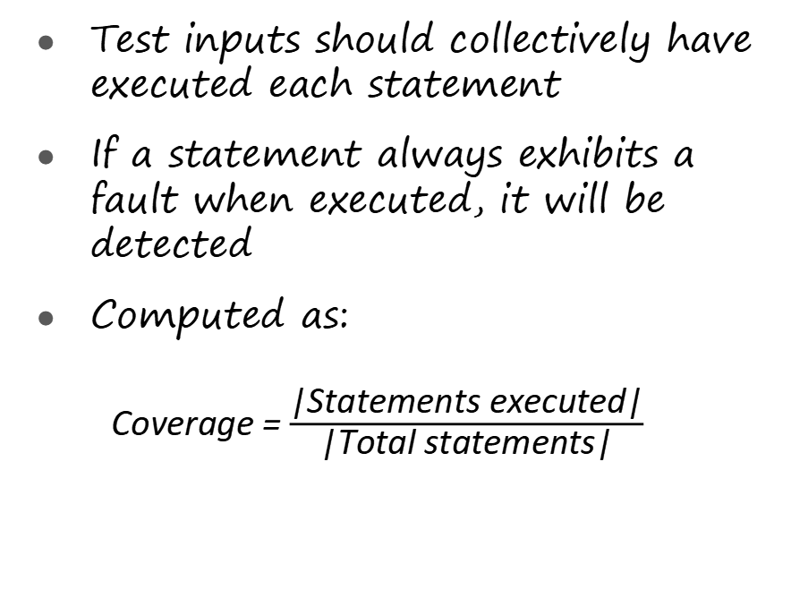
Statement Coverage
Test inputs should collectively have executed each statement
If a statement always exhibits a fault when executed, it will be detected
Computed as:
Coverage = $\frac{\text{|}\text{Statements} \text{executed}\text{|}}{\text{|}\text{Total} \text{statements}\text{|}}$

Slide 16







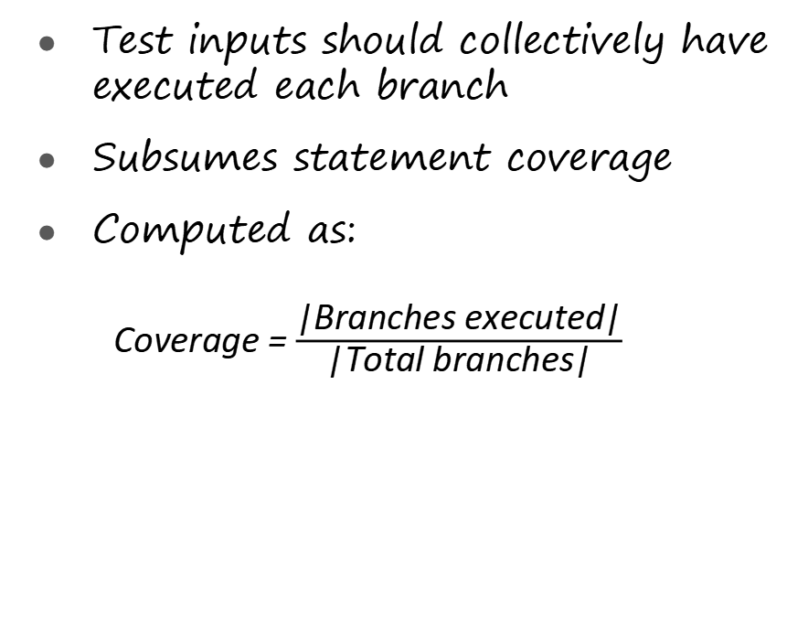
Branch Coverage
Test inputs should collectively have executed each branch
Subsumes statement coverage
Computed as:
Coverage = $\frac{\text{|}\text{Branches} \text{executed}\text{|}}{\text{|}\text{Total} \text{branches}\text{|}}$
Notes:
测试输入应共同执行每个分支
子科目报表覆盖范围
计算为：
覆盖率=|执行的分支机构|/|分支机构总数|

Slide 17
Testing: Black Box
Mauro Pezze and Michal Young. Software testing and analysis - process, principles and techniques. Wiley, 2007.

Slide 18
Black Box Testing
No access to “internals”
May have access, but don’t want to
We know the interface
Parameters
Possible functions / methods
We may have some form of specification document
Notes:
无法访问“内部”
可以访问，但不想访问
我们知道接口
参数
可能的功能/方法
我们可能有某种形式的规范文件

Slide 19
Testing Challenges
Many different types of input
Lots of different ways in which input choices can affect output
An almost infinite number of possible inputs & combinations
Notes:
许多不同类型的输入
输入选择可能影响输出的许多不同方式
几乎无限数量的可能输入和组合

Slide 20
Equivalence Partitioning (EP) Method
Identify tests by analysing the program interface
Decompose program into “functional units”
Identify inputs / parameters for these units
For each input
Identify its limits and characteristics
Define “partitions” - value categories
Identify constraints between categories
Write test specification
Notes:
通过分析程序接口识别测试
将程序分解为“功能单元”
识别这些单元的输入/参数
对于每个输入
确定其局限性和特点
定义“分区”-值类别
确定类别之间的约束
编写测试规范

Slide 21
Example – Generate Grading Component
The component is passed an exam mark (out of 75) and a coursework (c/w) mark (out of 25), from which it generates a grade for the course in the range 'A' to 'D'. The grade is calculated from the overall mark which is calculated as the sum of the exam and c/w marks, as follows:
greater than or equal to 70 - 'A' greater than or equal to 50, but less than 70 - ‘B’
greater than or equal to 30, but less than 50 - ‘C’
less than 30 - 'D'
Where a mark is outside its expected range then a fault message ('FM') is generated. All inputs are passed as integers.
Notes:
该组成部分通过了一个考试分数（满分75分）和一个作业（c/w）分数（满分25分），由此产生的课程成绩在“a”到“D”之间。成绩是根据总成绩计算的，总成绩是考试成绩和c/w成绩的总和，如下所示：
大于或等于70-“A”大于或等于50，但小于70-“B”
大于或等于30，但小于50-“C”
小于30-“D”
如果标记超出其预期范围，则会生成故障消息（“FM”）。所有输入都以整数形式传递。

Slide 22
EP – 1. Decompose into Functional Units
Dividing into smaller units is good practice
Possible to generate more rigorous test cases.
Easier to debug if faults are found.
E.g.: dividing a large Java application into its core modules / packages
Already a functional unit for the Grading Component example
Notes:
划分成更小的单元是一种很好的做法
可以生成更严格的测试用例。
如果发现故障，则更易于调试。
例如：将大型Java应用程序划分为其核心模块/包
已经是放坡构件示例的功能单元

Slide 23
EP – 2. Identify Inputs and Outputs
For some systems this is straightforward
E.g., the Triangle program:
Input: 3 numbers,
Output: 1 String
E.g., Grading Component
Input: 2 integers: exam mark and coursework mark
Output: 1 String for grade
For others less so. Consider the following:
A phone app.
A web-page with a flash component.
Notes:
对于某些系统来说，这很简单。例如，三角形程序：
输入：3个数字，
输出：1个字符串
例如，评分组件
输入：2个整数：考试成绩和课程作业成绩
输出：1个字符串表示成绩
对于其他系统来说，则不那么直接。考虑以下情况：
一个手机应用程序。
一个带有 Flash 组件的网页。

Slide 24
EP – 3.a Identify Categories
Category | Description
Valid | valid exam mark
 | valid coursework mark
 | valid total mark
Invalid | invalid exam mark
 | invalid coursework mark
 | Invalid total mark
Notes:
Description
valid exam mark
valid coursework mark
valid total mark
invalid exam mark
invalid coursework mark
Invalid total mark

Slide 25
EP: 3.b Define “Partitions” - value categories
Significant value ranges / value-characteristics of an input
Category | Description | Partition
Valid | EM_1 valid exam mark | 0 ≤ Exam mark ≤ 75
 | CM_1 valid coursework mark | 0 ≤ Coursework mark ≤ 25
Invalid | EM_2 invalid exam mark | Exam mark > 75
 | EM_3 invalid exam mark | Exam mark < 0
 | EM_4 invalid exam mark | alphabetic
 | EM_5 invalid exam mark | Other real number (outside of EM_1)
 | CM_2 invalid coursework mark | Coursework mark > 25
 | CM_3 invalid coursework mark | Coursework mark < 0
 | CM_4invalid coursework mark | alphabetic
 | CM_5 invalid coursework mark | Other real number (outside of CM_1)
Notes:
描述分区
EM_1有效考试成绩0≤考试成绩≤75
CM_1有效课业成绩0≤课业成绩≤25
EM_2考试成绩无效考试成绩>75
EM_3考试成绩无效考试成绩＜0
EM_4无效的考试成绩字母
EM_5考试成绩无效
其他实数（EM_1以外）
CM_2无效作业分数作业分数>25
CM_3无效作业分数作业分数<0
CM_4无效的作业标记字母
CM_5无效作业分数其他实数（CM_1以外）

Slide 26
EP – 3. c Identify Constraints between Categories
Not all categories can combine with each other
Category |  | Condition
valid exam mark | EM_1 | 0 ≤ Exam mark ≤ 75
invalid exam mark | EM_2 | Exam mark > 75
invalid exam mark | EM_3 | Exam mark < 0
invalid exam mark | EM_4 | alphabetic
invalid exam mark | EM_5 | Other real number
valid coursework mark | CM_1 | 0 ≤ Coursework mark ≤ 25
invalid coursework mark | CM_2 | Coursework mark > 25
invalid coursework mark | CM_3 | Coursework mark < 0
invalid coursework mark | CM_4 | alphabetic
invalid coursework mark | CM_5 | Other real number

Slide 27
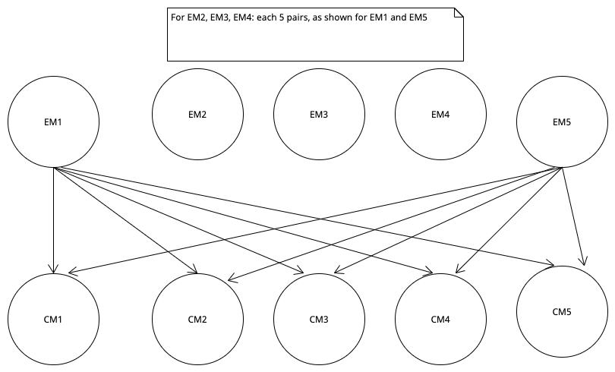
EP – 3. d Write Test Specifications

Slide 28
Example: Inputs and Expected Outputs

Slide 29
Boundary Values
Most frequently errors occur in "edge" cases
Test just under boundary value
Test just above the boundary value
Test the boundary value
Notes:
最常见的错误发生在“边缘”情况下
在边界值下测试
测试刚好高于边界值
测试边界值

Slide 30
How do we go about using this?
Testing applied in Java: Use JUnit
uses “Assertions” to test the code
Allow us to state what should be the case
If assertions do not hold, JUnit’s logging mechanisms reports failures
Various types of assertion are available, e.g., assertEquals( expected, actual ); assertTrue( condition ); assertFalse( condition ); assertThat ( value, matchingFunction )
Notes:
Java中应用的测试：使用JUnit
使用“断言”来测试代码
请允许我们说明应该是什么情况
如果断言不成立，JUnit的日志记录机制会报告失败
可以使用各种类型的断言，例如assertEquals（预期的、实际的）；assertTrue（条件）；assertFalse（条件）；assertThat（value，matchingFunction）

Slide 31
Review
What is Software Quality?
What are key elements and relationships for test specifications?
How do we carry out white-box testing?
How do we carry out black-box testing?
Notes:
A. System behavior is how a system acts and reacts. It is an outwardly visible and testable activity of a system.
B. A use-case model describes a system’s functional requirements in terms of use cases. It is used to communicate with the end users and the domain experts. A benefit includes buy-in at an early stage of system development.
C. An actor is anything that exchanges data with the system and is external to the system. A use case is a sequence of actions a system performs that yields an observable result of value to a particular actor.
D. An activity diagram in the use-case model can be used to capture the activities in a use case. It is essentially a flow chart, showing flow of control from activity to activity.
什么是软件质量？
测试规范的关键要素和关系是什么？
我们如何进行白盒测试？
我们如何进行黑盒测试？
软件质量指的是软件产品在满足用户需求和期望的同时，具备高可靠性、高安全性、高性能和良好用户体验等特性的程度。
测试规范的关键要素包括测试目标、测试方法、测试环境、测试数据、测试用例和测试报告。这些要素之间相互关联，共同确保测试过程的有效性和完整性。
白盒测试是一种测试方法，通过分析软件内部的代码结构、逻辑和算法来进行测试。白盒测试通常涉及测试覆盖率、路径覆盖、语句覆盖等技术，以确保软件在逻辑和代码层面的正确性。
黑盒测试是一种测试方法，不关心软件的内部结构和实现细节，而是关注软件的功能和用户界面。黑盒测试通过输入数据和预期输出结果来验证软件是否符合规格和用户需求，以确保软件的功能和性能符合预期。

